Slide 1
Donagh N.S.
Maths Week
Junior Room

Slide 2
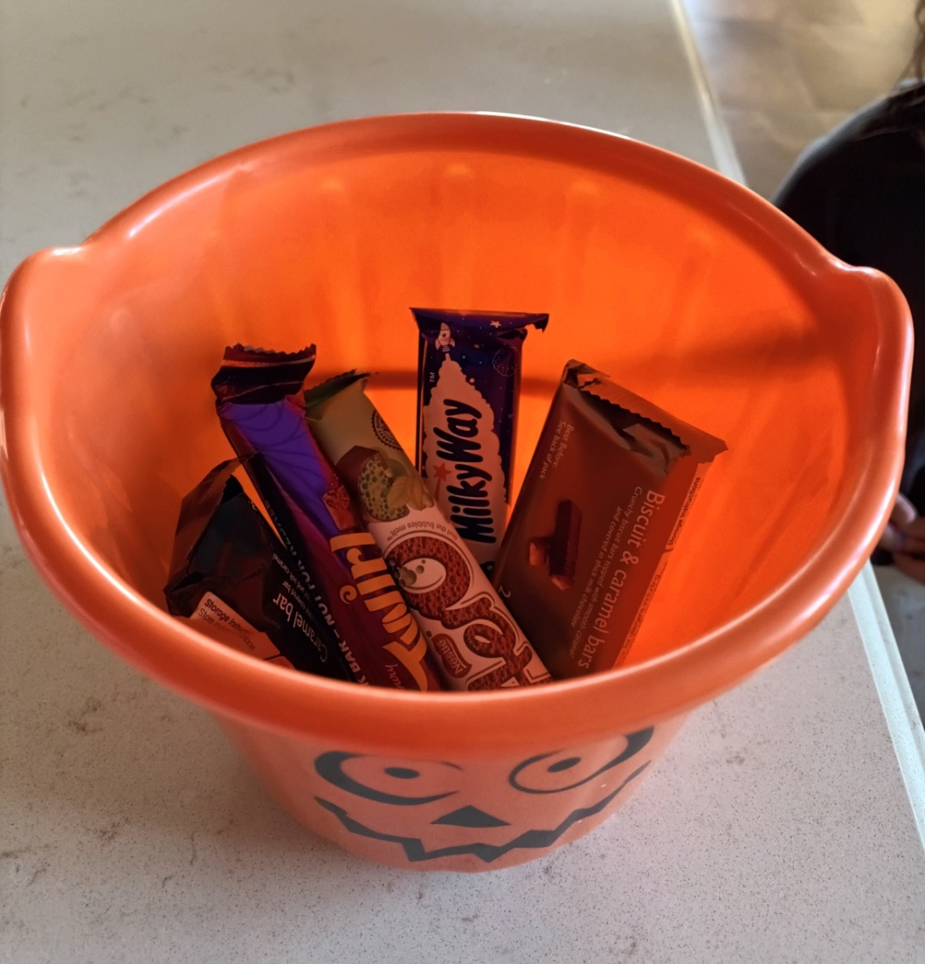
How many
treats are
in the
bucket?

Slide 3
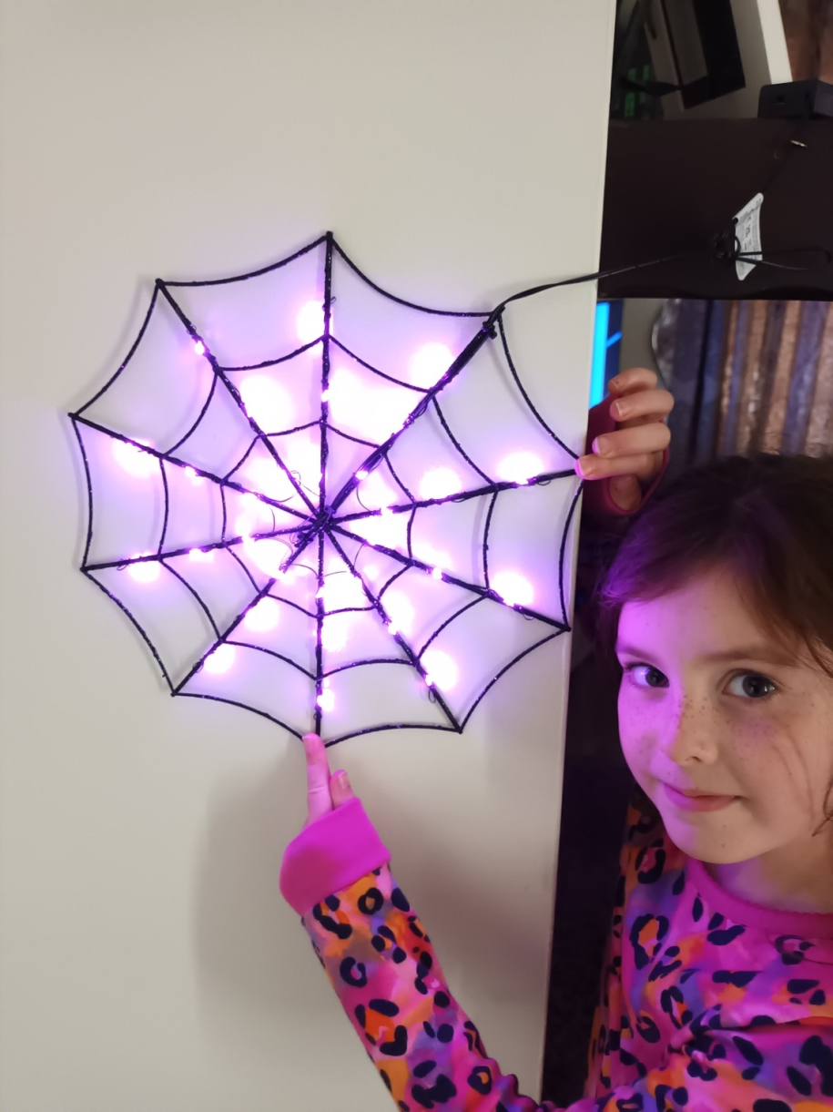
How many
lines of
symmetry
can you see?

Slide 4
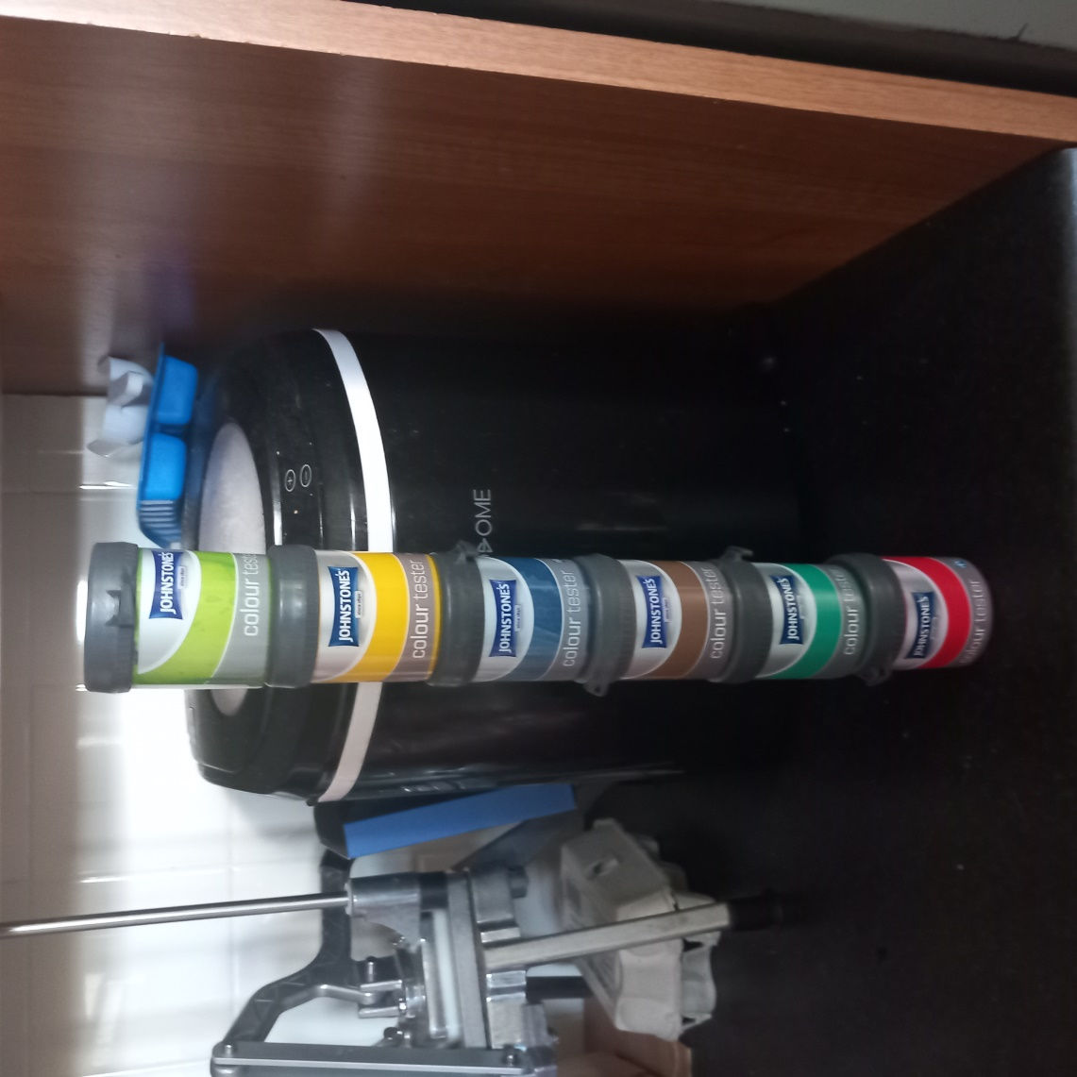
How many pots
of paint do
you see?
If 3 of them
were used up,
how many
would you
have left?

Slide 5
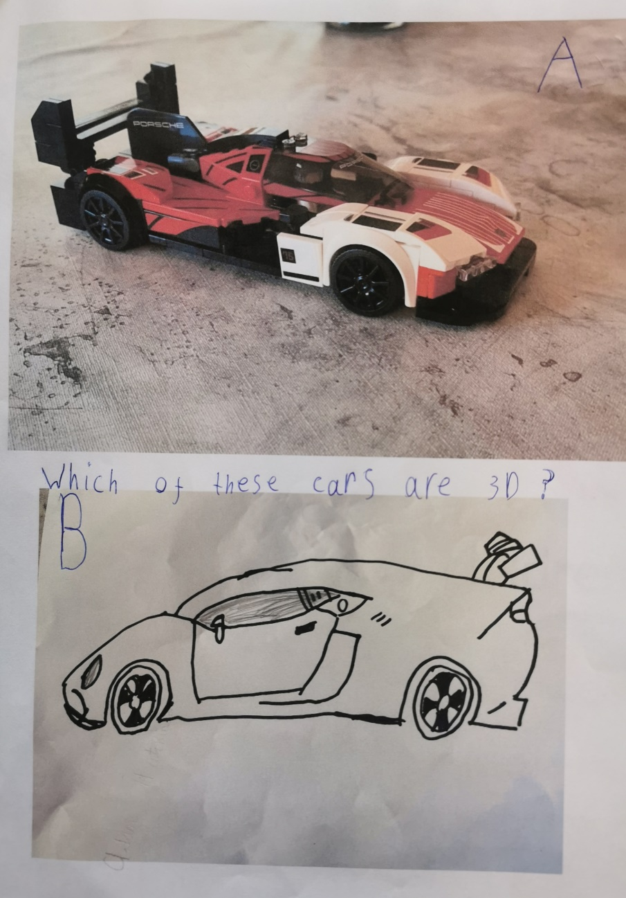
Which of
these cars
are 3D?

Slide 6
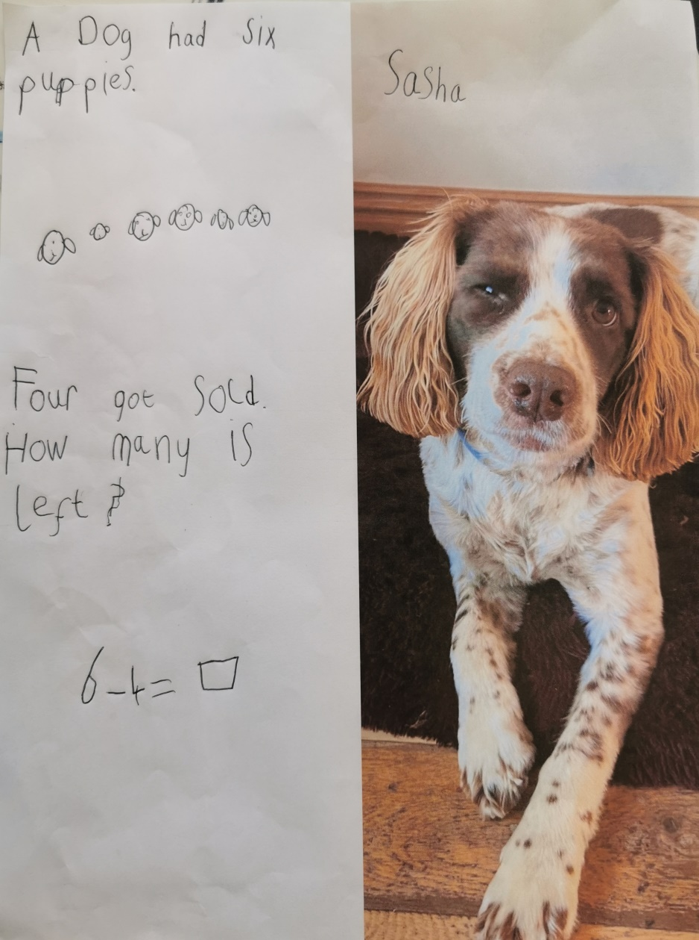
A dog has 6 puppies
4 get sold.
How many are left?
6 – 4 =

Slide 7
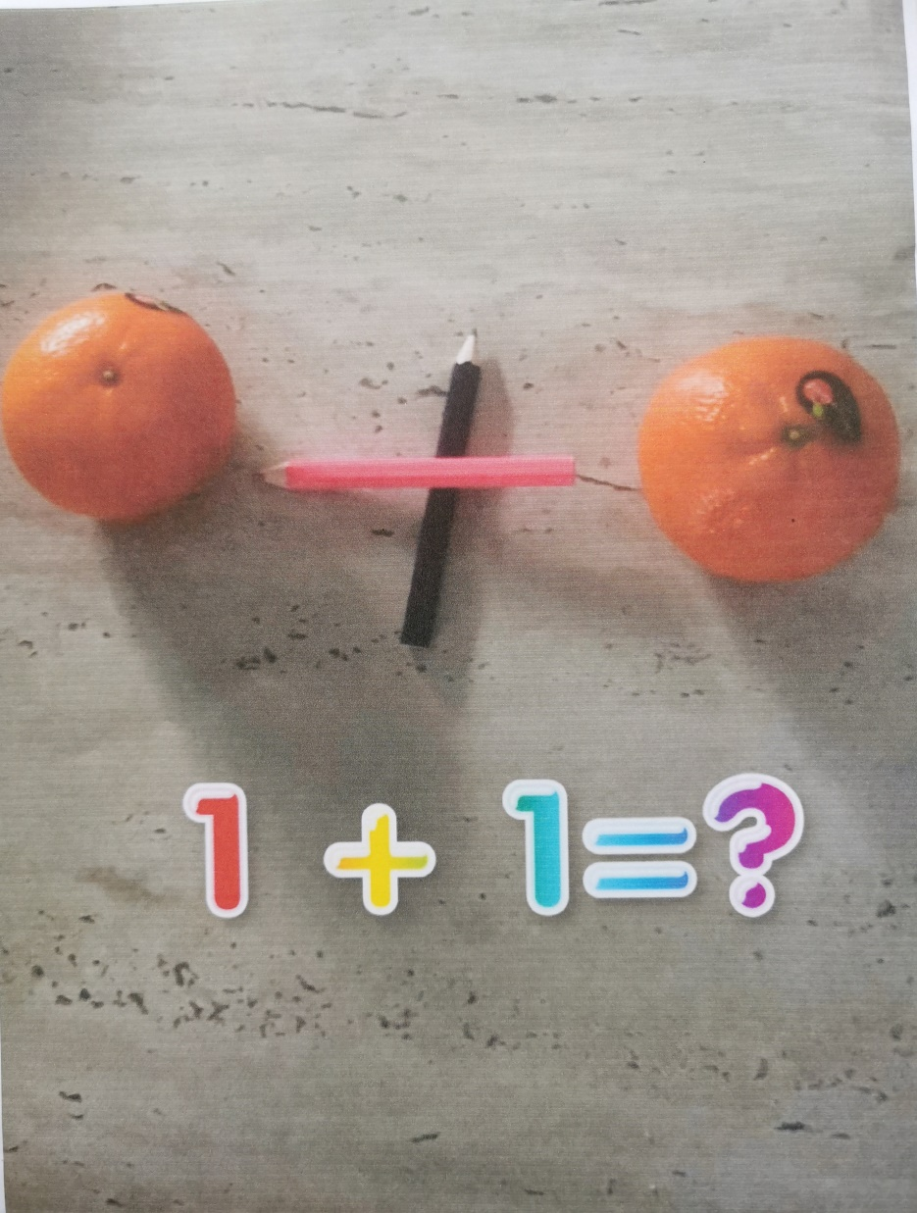
1 + 1 =

Slide 8
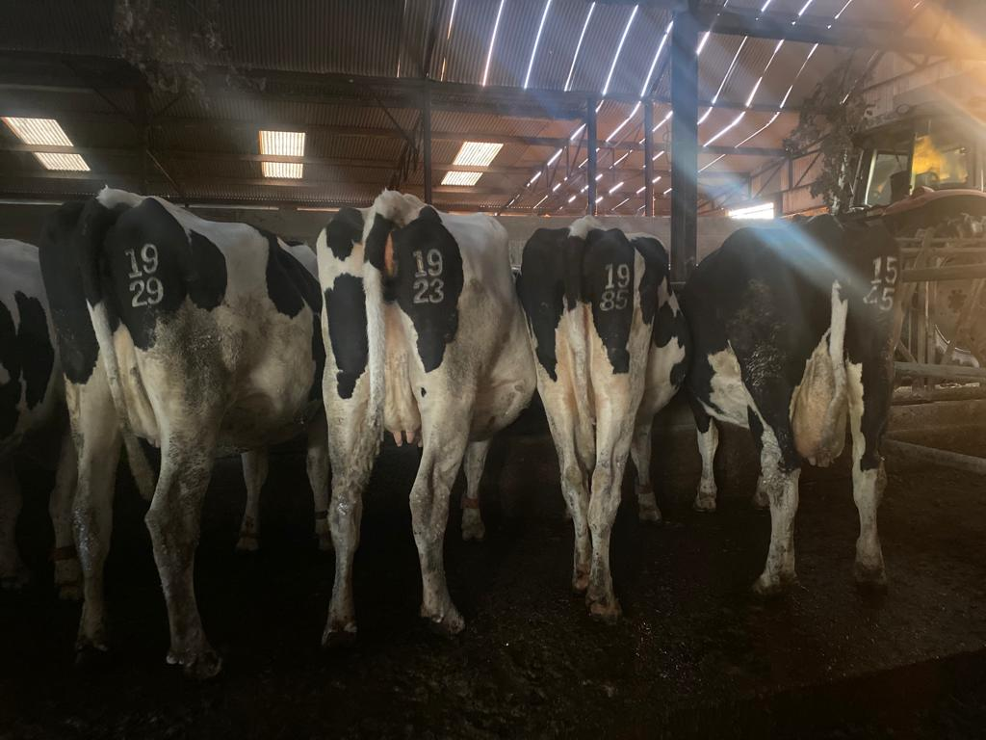
How many legs
can you see
in the picture?

Slide 9
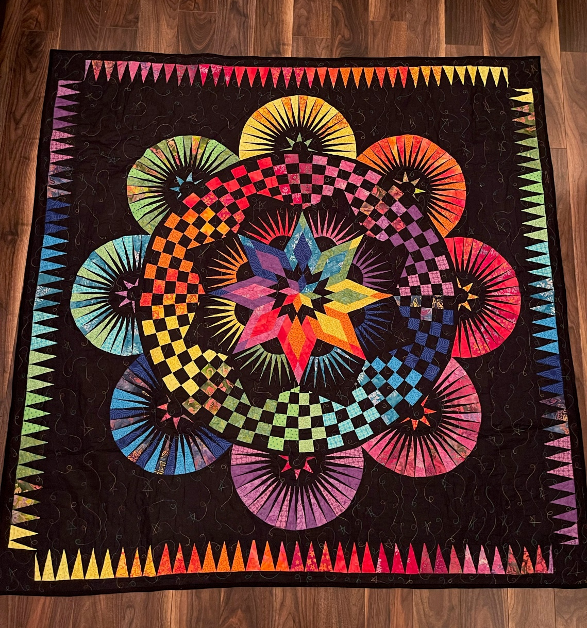
How many different shapes and colours can be seen on the throw?

Slide 10
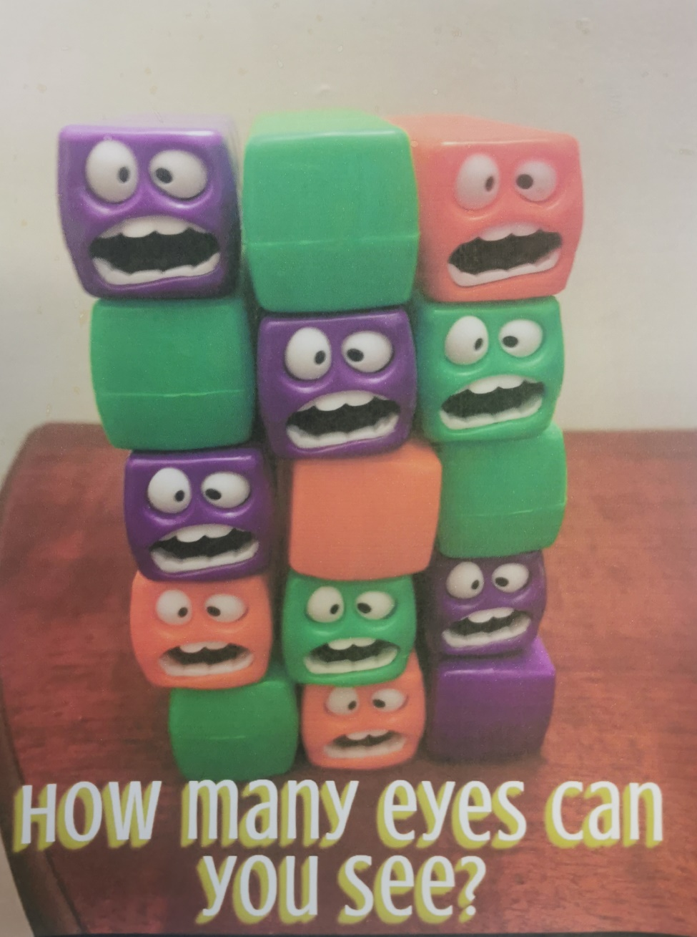
How many eyes can you see?

Slide 11
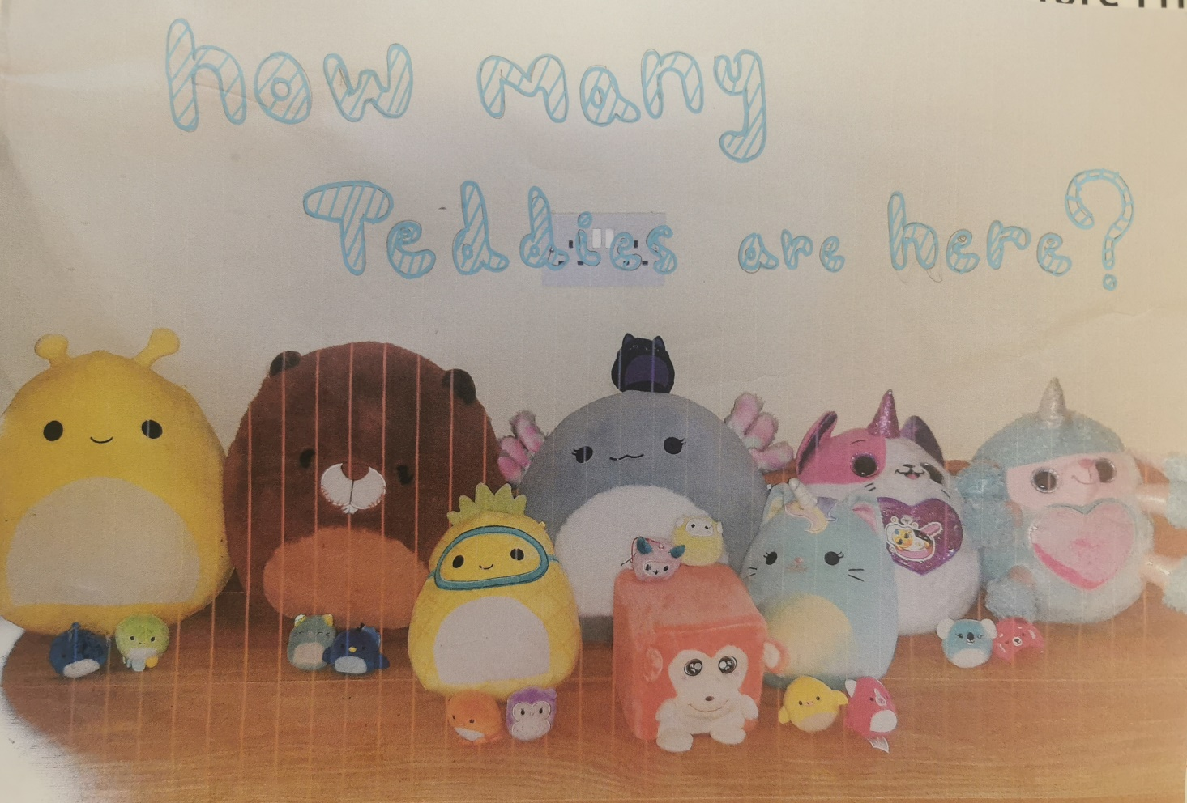
How many teddies are here?

Slide 12
How many more Massey tractors are there than John Deere tractors?

