Slide 1
Donagh N.S.
Maths Week
Senior Room

Slide 2
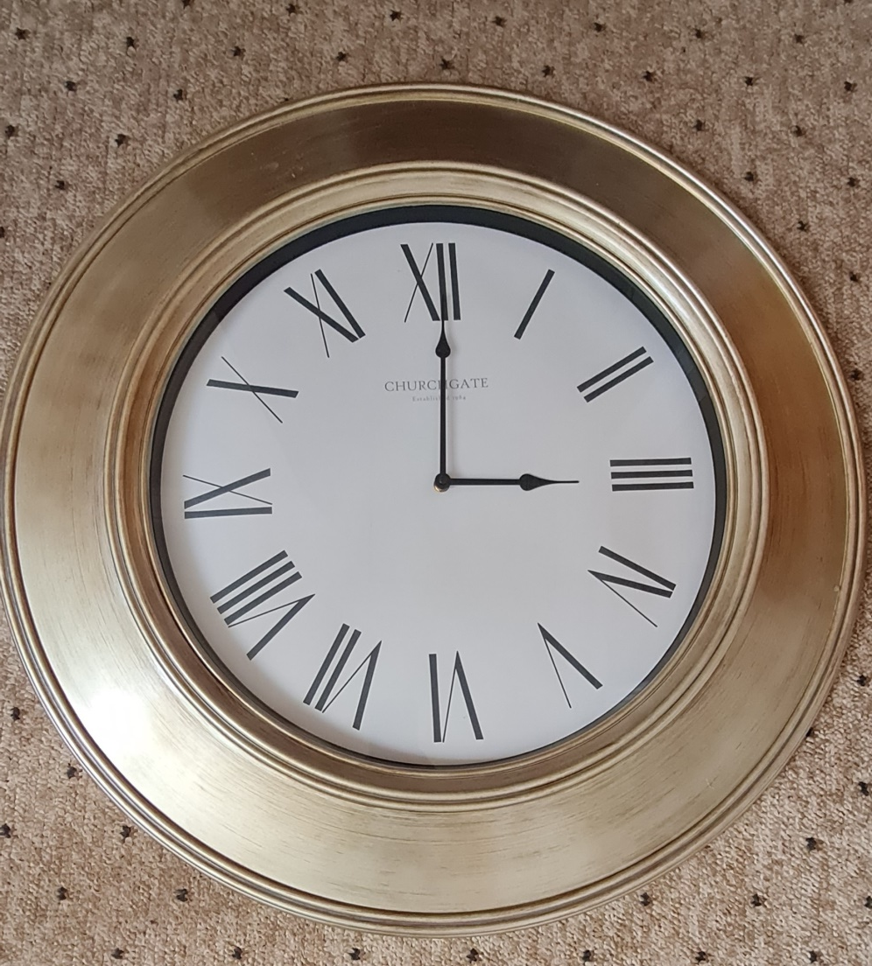
If this clock's
time shows a
90° angle,
what is the
value of the
reflex angle?

Slide 3
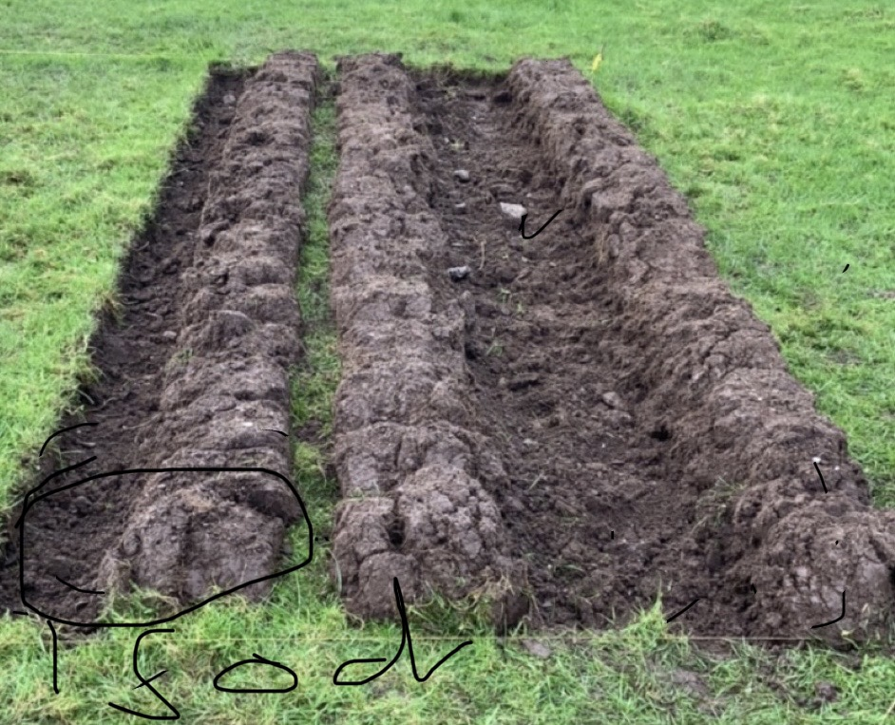
What width will my plot end up if each of my sods will be 21 inches wide with a 4 inch gap between
my first and
second rows?
(Hint remember this is 3 rows you see in the picture)

Slide 4
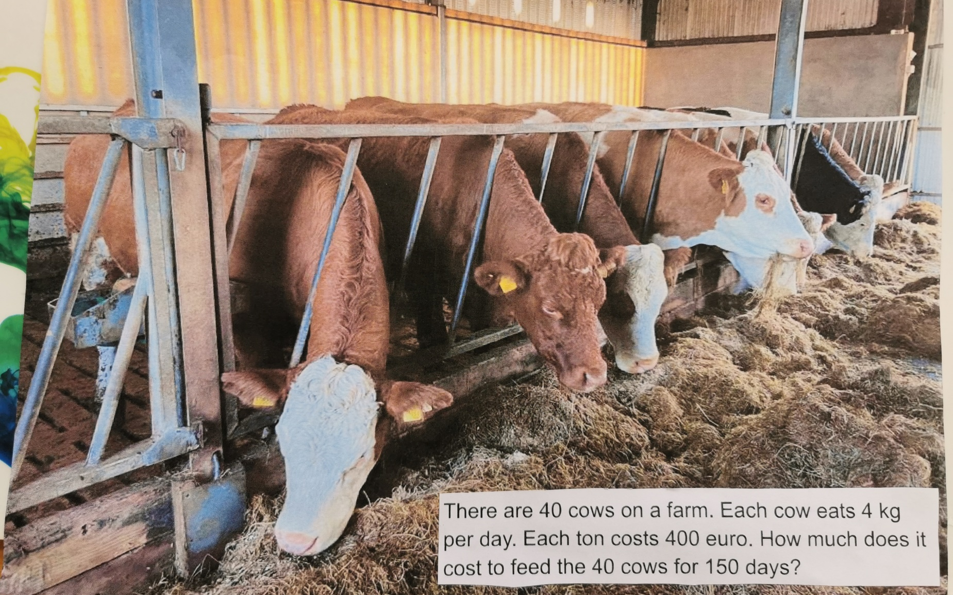

Slide 5
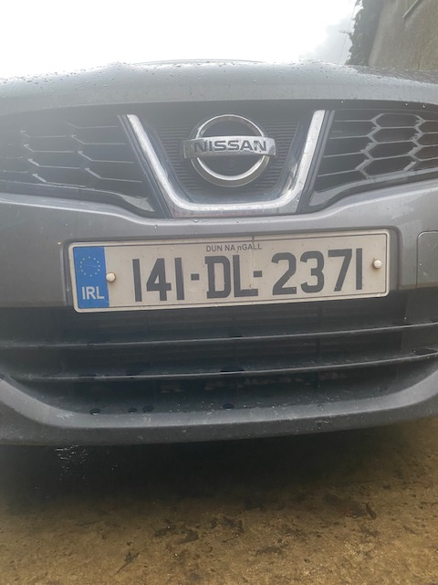
What is the average
number of this
number plate?

Slide 6
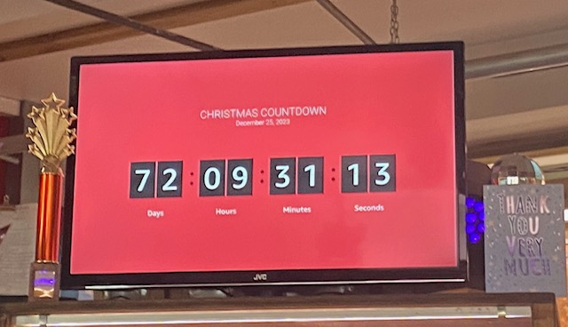
How many times can you get the number 9 by adding numbers in this countdown?

Slide 7
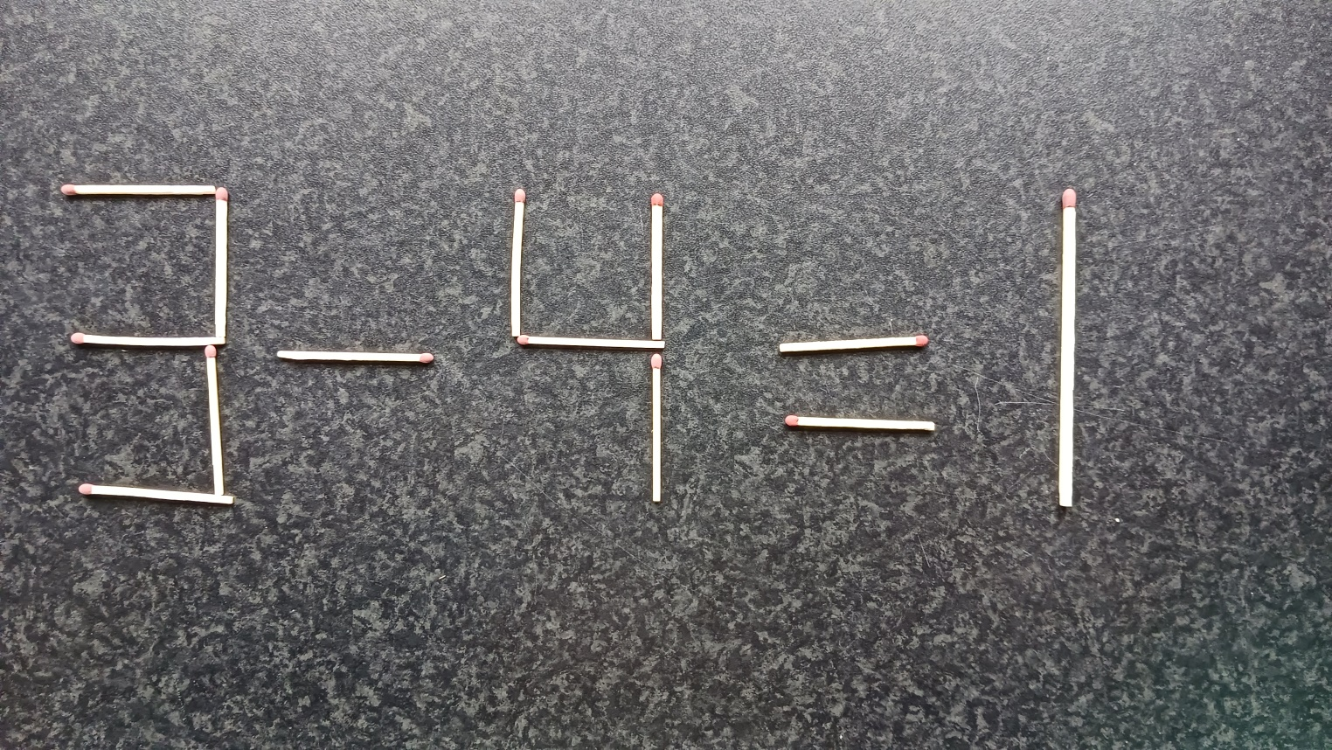
What 1 match can you move to make this sum correct answer?

Slide 8
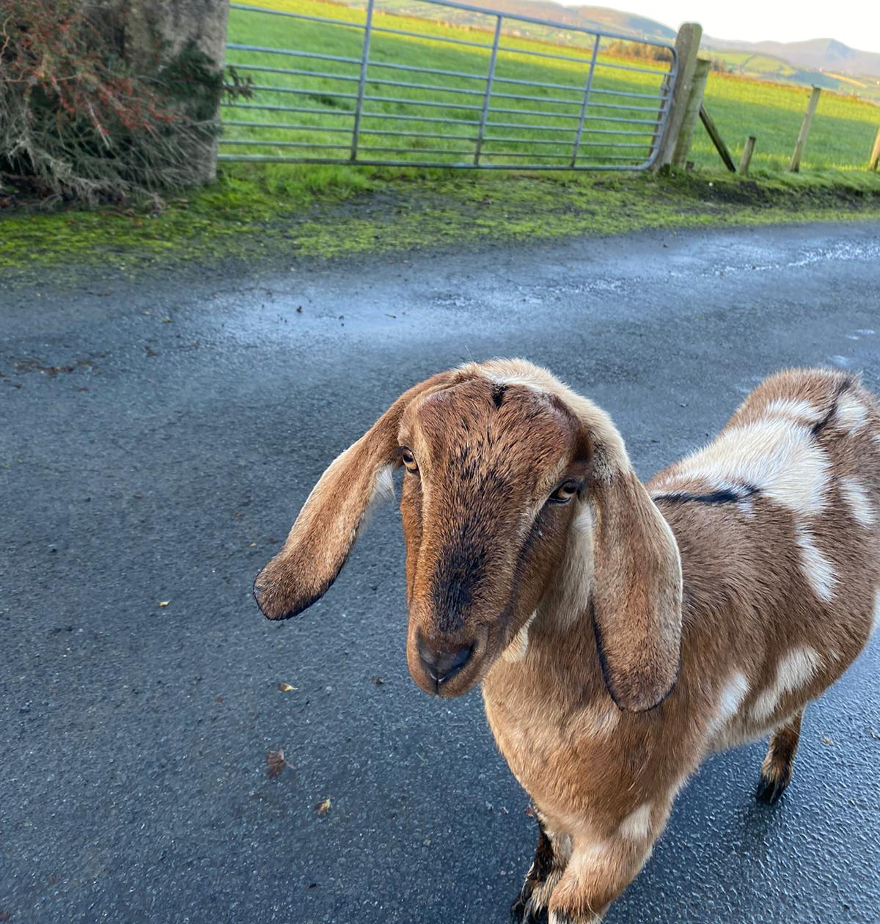
Bonnie eats
75g of nuts
twice a day.
How many grams
does she get in
one week?

Slide 9
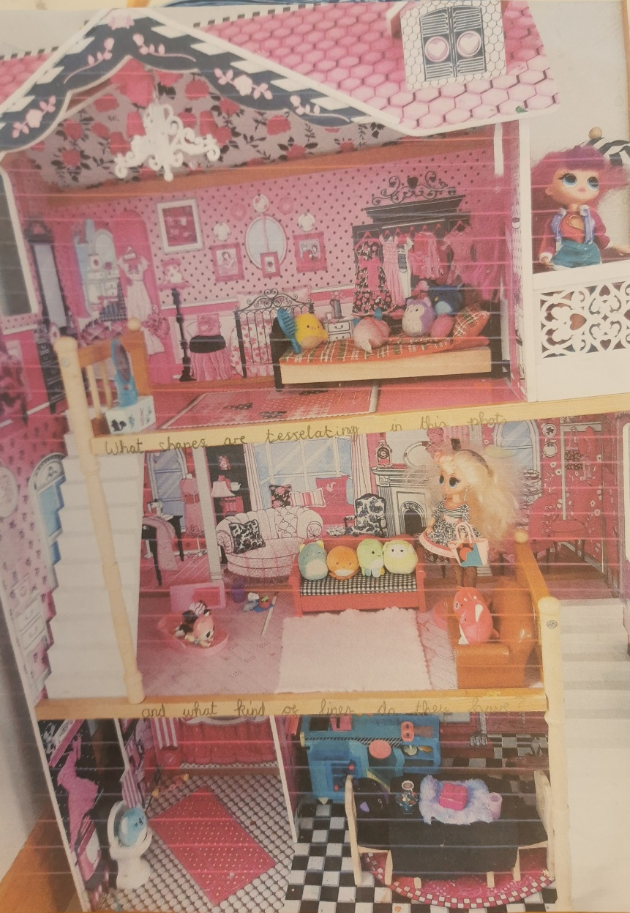
What shapes are tessellating in this photo and
what kind of lines do they have?

Slide 10
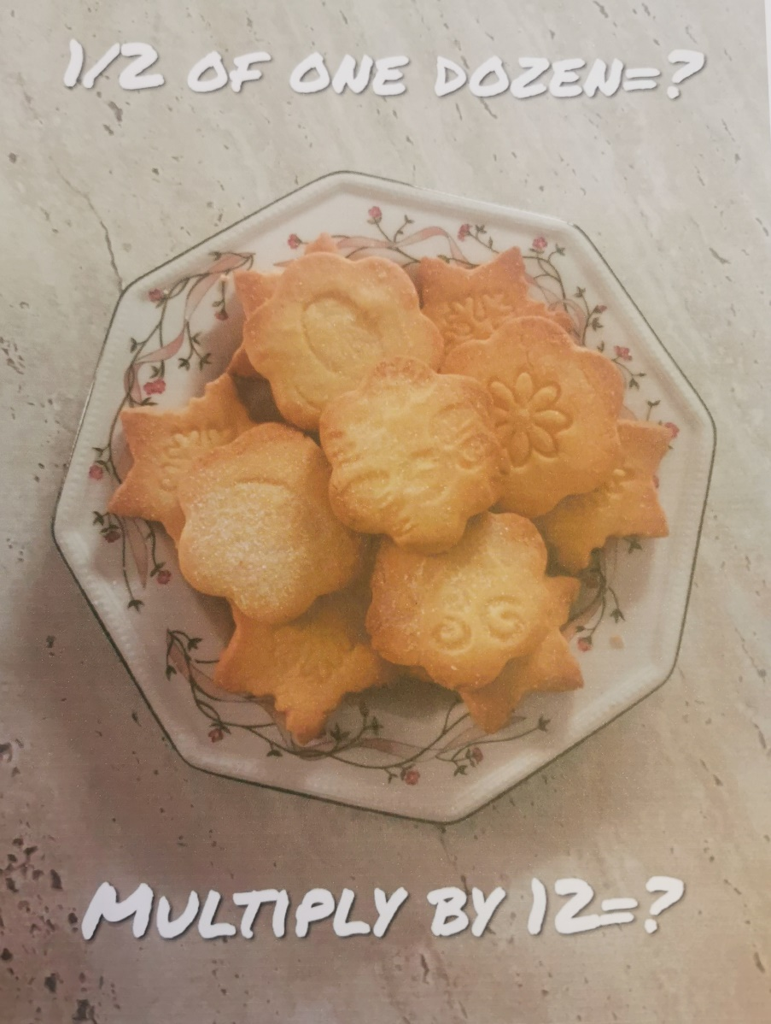
½ of one dozen =
Multiply by 12 =

Slide 11
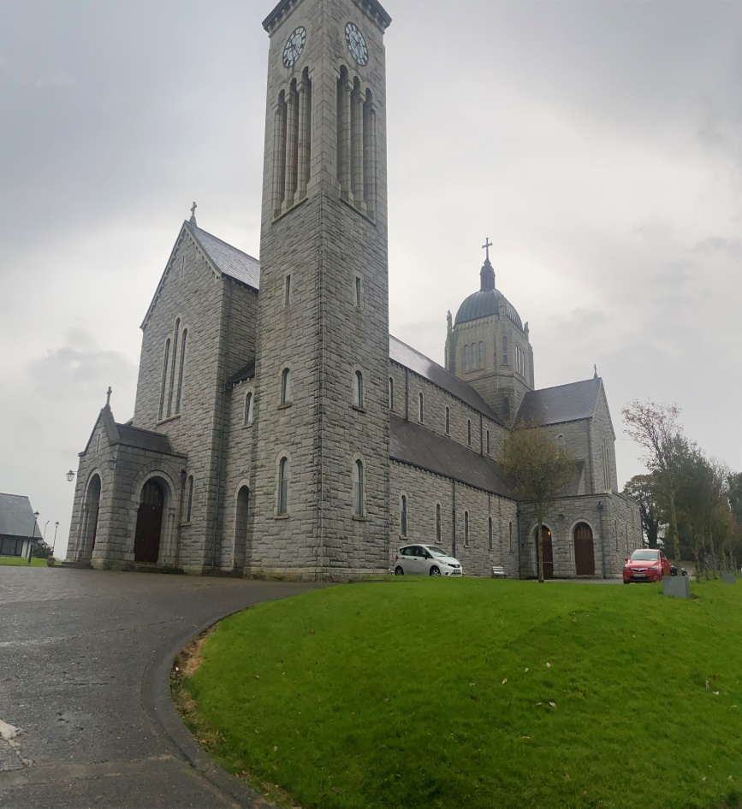
How many parallel lines do you see?
(Not including window and door).

Slide 12
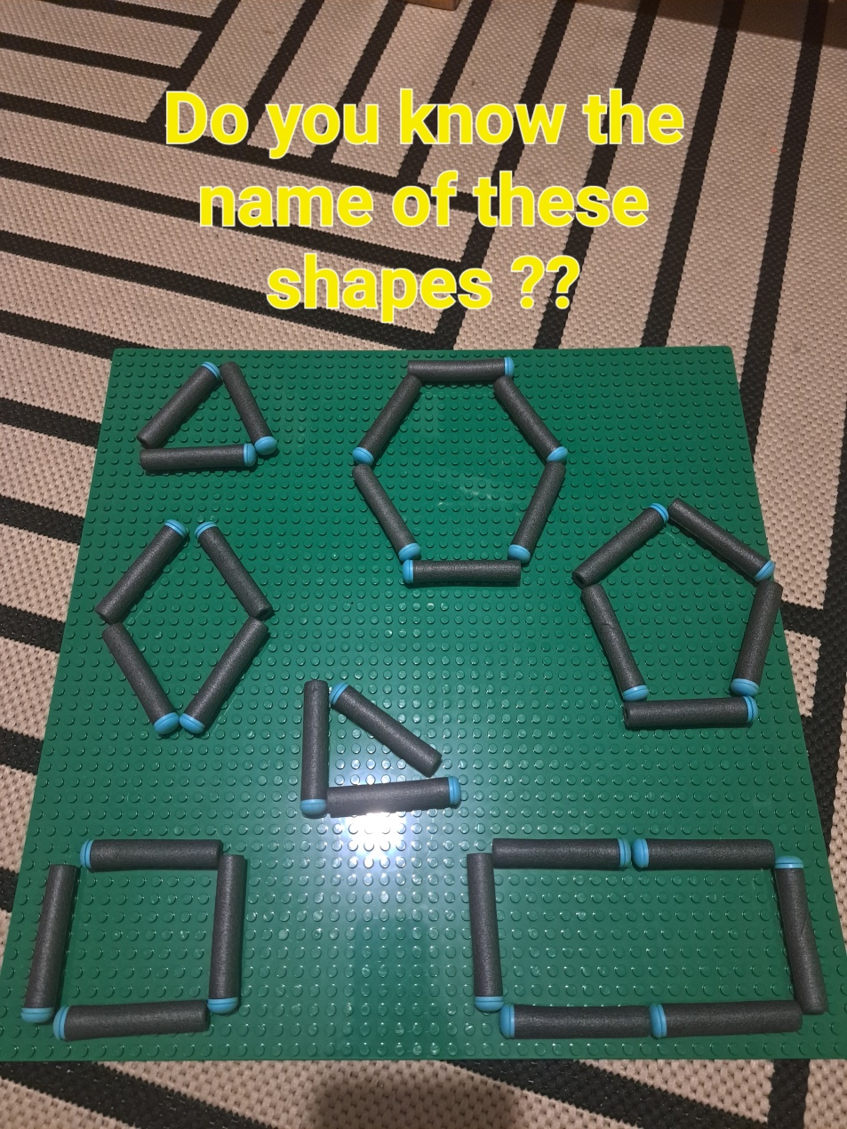
Do you know the name of these shapes?

Slide 13
Look at the pattern.
How many dots would there be on the next ‘square’?

Slide 14
How many years from the last dual to the last passenger from Buncrana to Carndonagh?

Slide 15
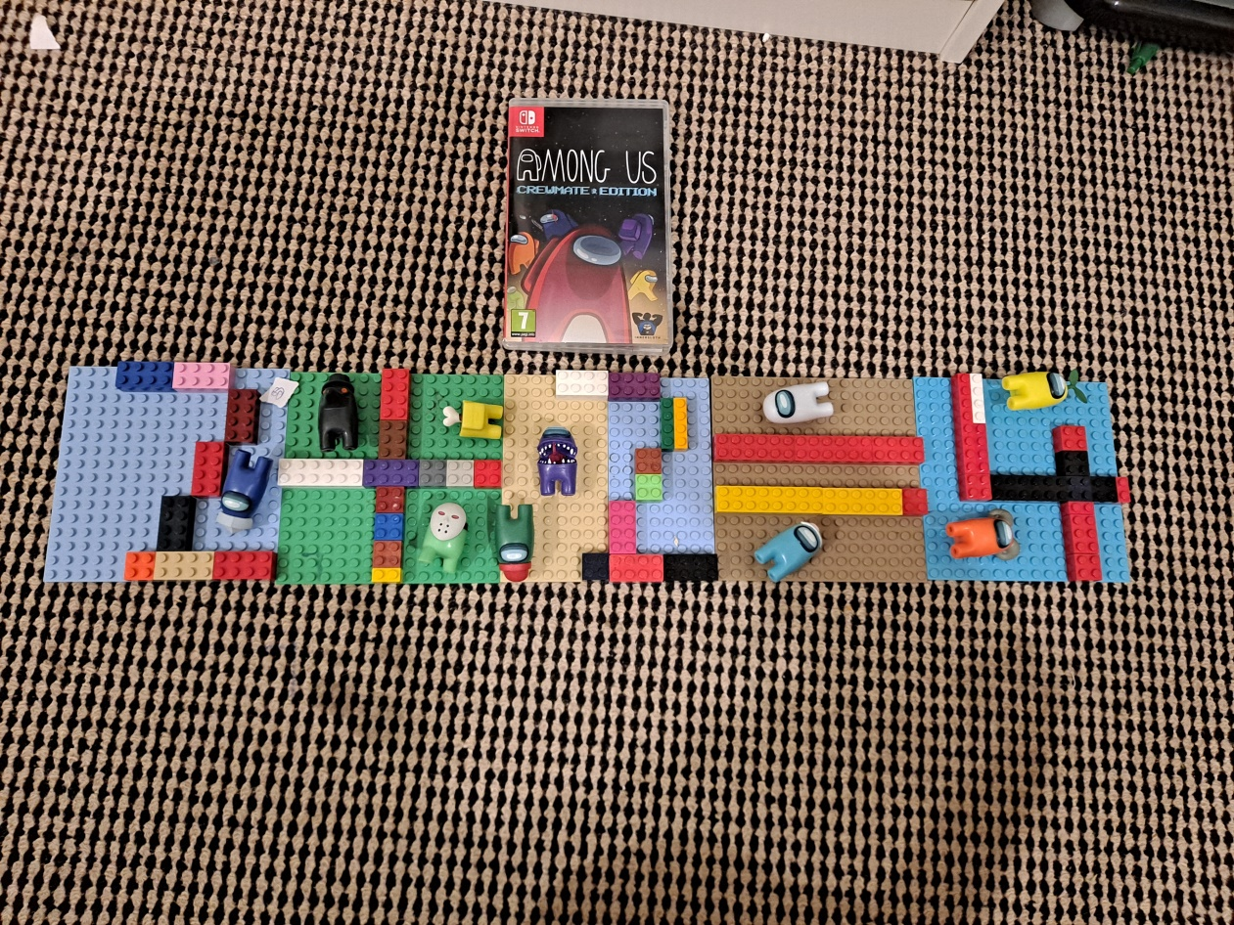
How many right angles can you see?

Slide 16
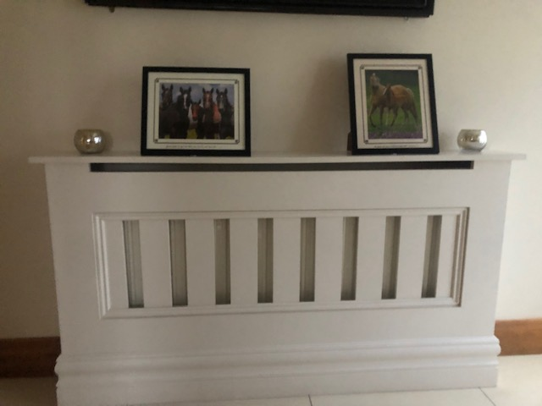
How many parallel lines are there?

Slide 17
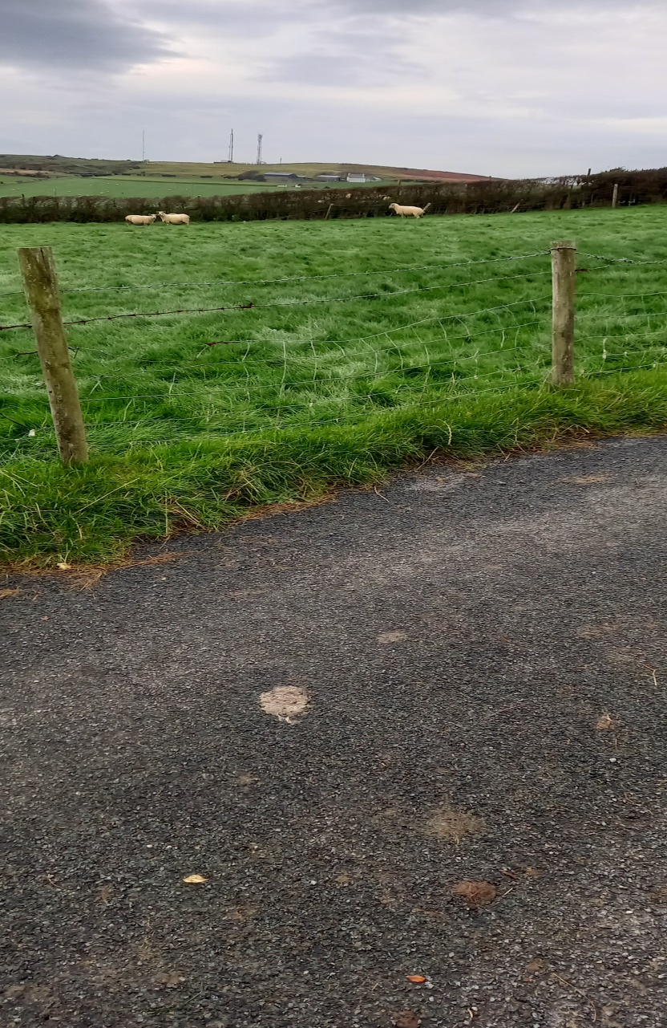
If a field is 600m with two 3.5 m gates and I want a 2m post gap, how many posts will I need?

Slide 18
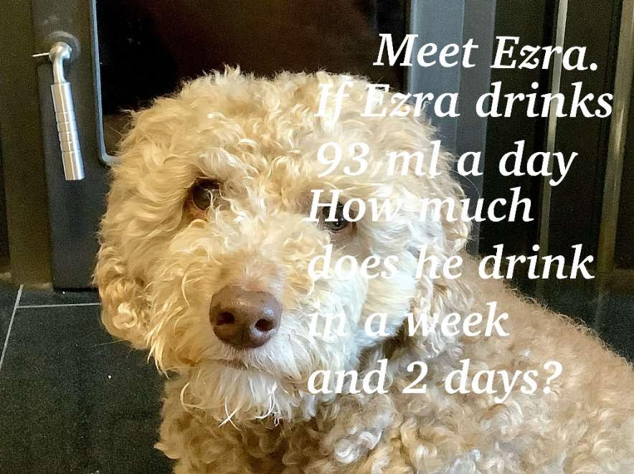
Meet Ezra!
If Ezra drinks 93ml a day, how much does she drink in a week and 2 days?

Slide 19
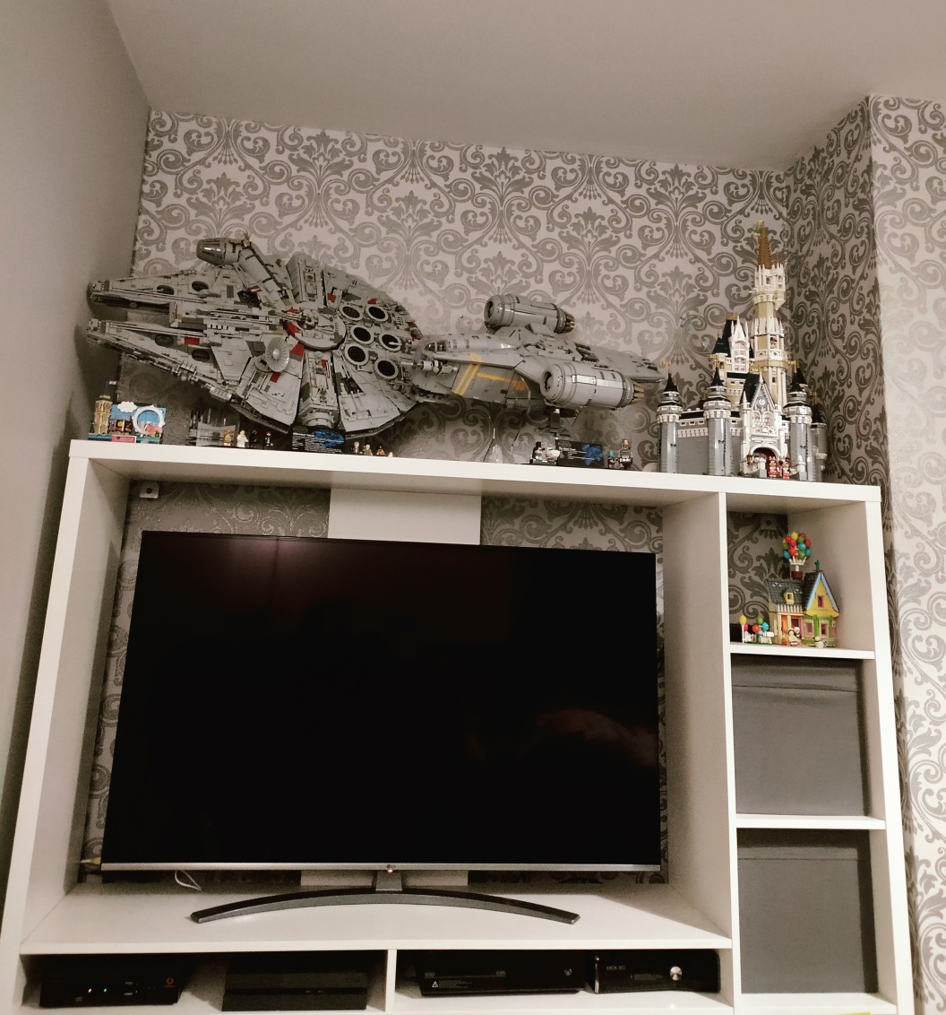
How many right angles are in this photo?

